Slide 1
Chapter 3
Data Analyses

Slide 2
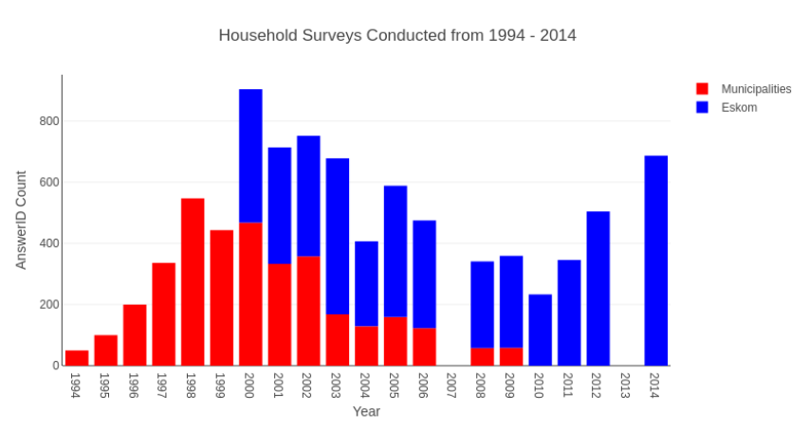
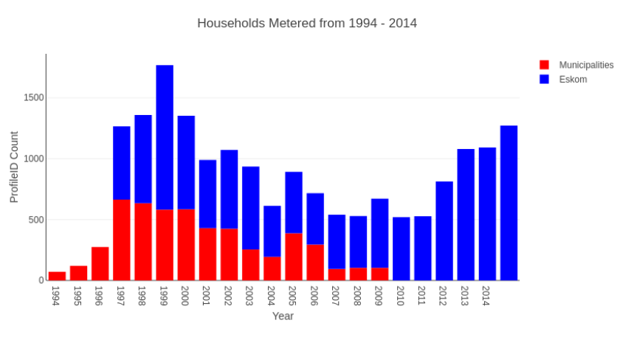
Number of Meters Installed vs Number of Surveys Conducted
Shows that there are more meters than surveys.
Not sure how many businesses there are.
Reason why filtering is needed to differentiate between business and residential buildings.

Slide 3
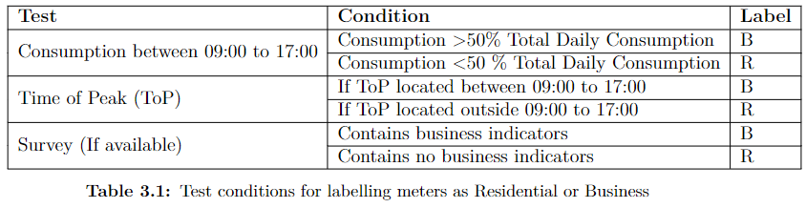
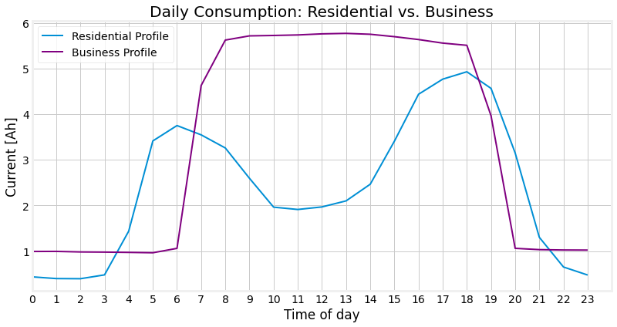
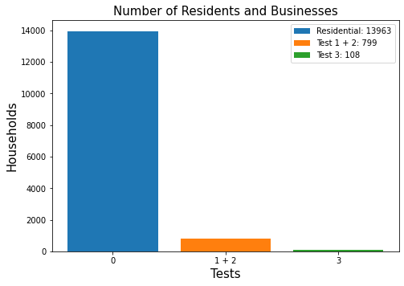
Businesses vs. Households After Filtering
Filtering Test Conditions
Filtering Tests designed using figure below
Results after filtering

Slide 4
Chapter 4
Methods

Slide 5
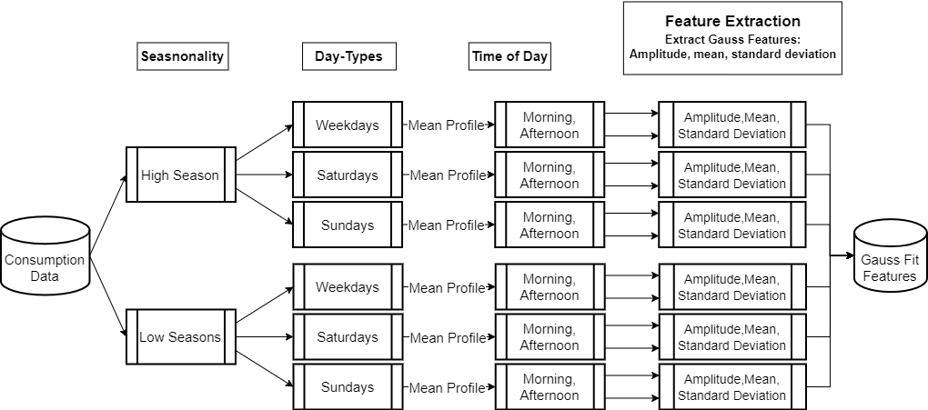
Modelling Load Profiles Shape: Flow Diagram

Slide 6
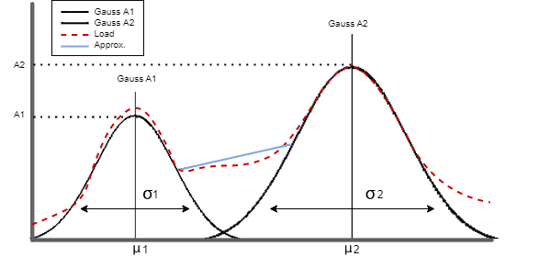
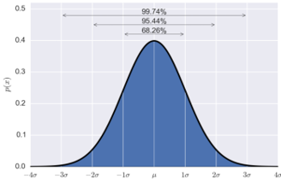
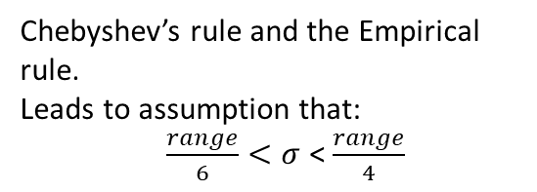
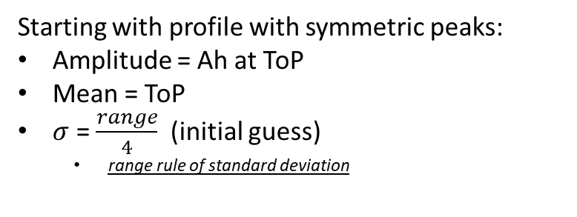
Creating Model: Load Profiles with symmetric peaks
Chebyshev’s rule and the Empirical rule.
Leads to assumption that:
$\frac{range}{6}<σ$ < $\frac{range}{4}$
Starting with profile with symmetric peaks:
Amplitude = Ah at ToP
Mean = ToP
$σ$ = $\frac{range}{4}$ (initial guess)
range rule of standard deviation

Slide 7
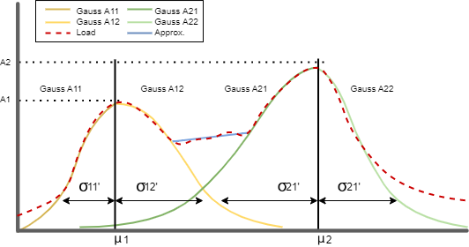
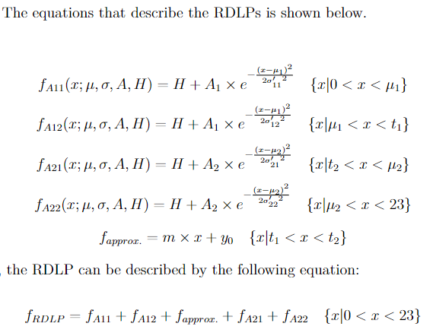
Creating Model: Load Profiles with Asymmetric Peaks
The four gauss model for describing a profiles shape.

Slide 8
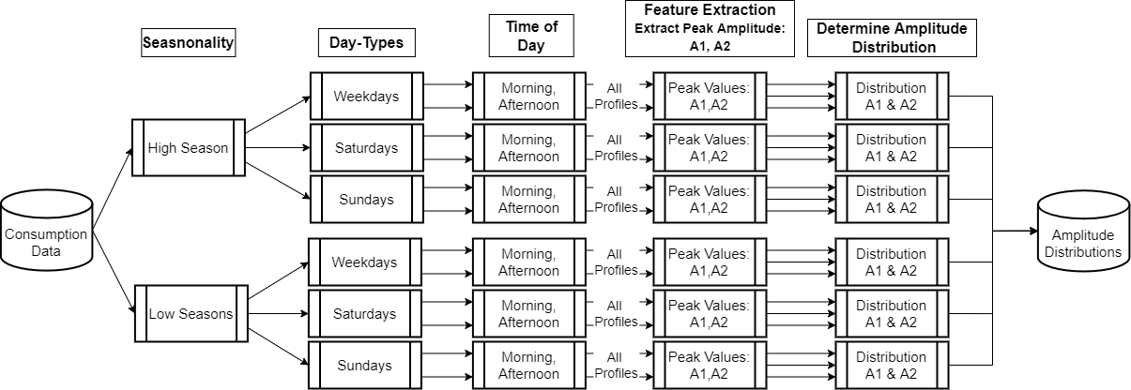
Modelling the Amplitude Variation: Flow Diagram

Slide 9
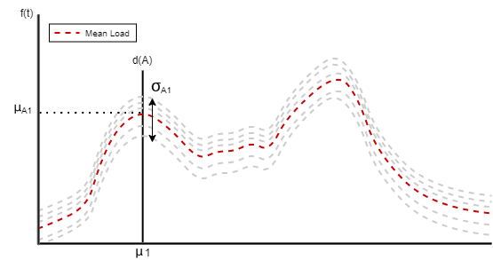
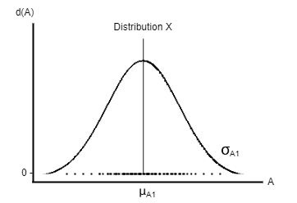
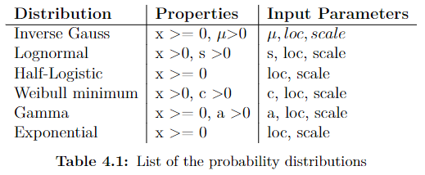
Describing Amplitudes with Probabilistic Distributions
Load profiles in a seasonal and day-type subset
Distribution of profiles peak amplitudes
Select distribution that describes the peaks using Chi-squared.

Slide 10
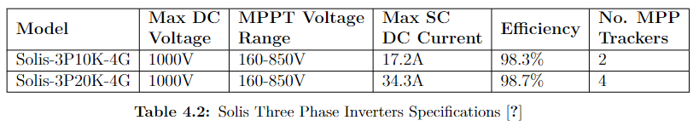
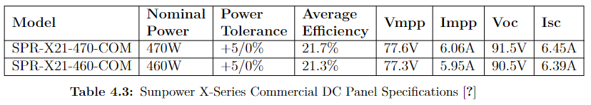
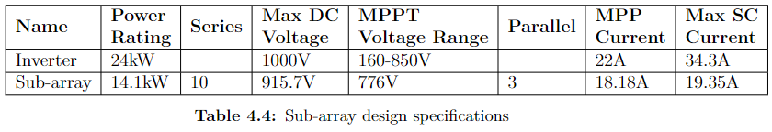
PV System Design
Inverter Selection
Panel Selection
Sub-array Design

Slide 11
Chapter 5
Results

Slide 12
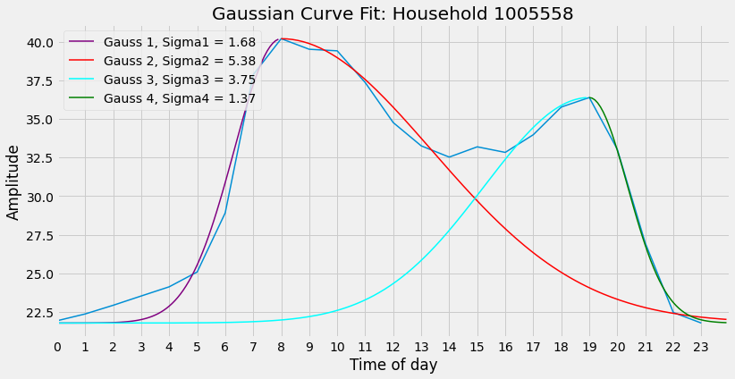
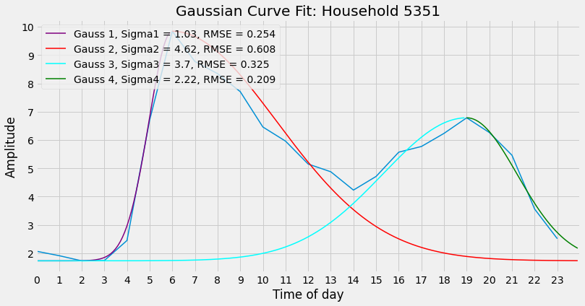
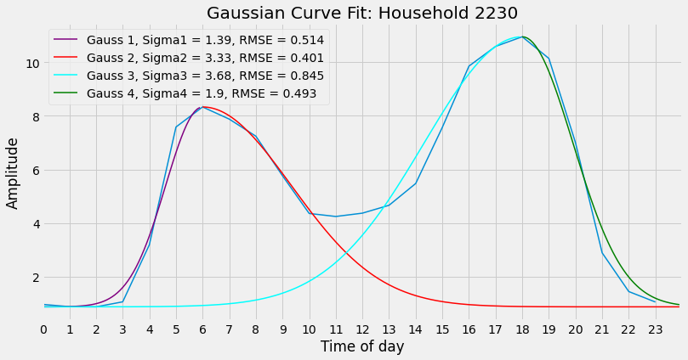
Simulating Profile Shape:Gaussian Curve Fit
Example of how the synthetic profiles mean is described using gaussians.

Slide 13
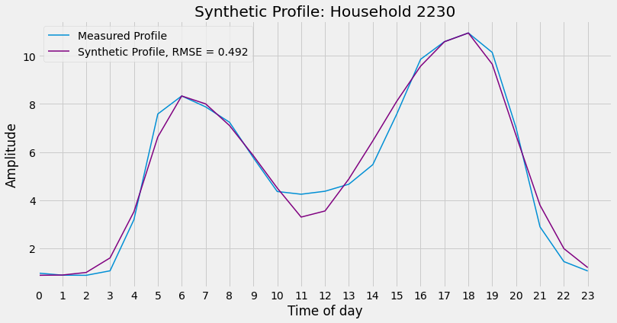
Simulating Profile Shape
Figure show the synthetic mean profile consisting out of 4 gaussians and a straight line approximation.
Before
After
Can give examples in the thesis of synthetic profiles which described the actual well and ones that performed poorly

Slide 14
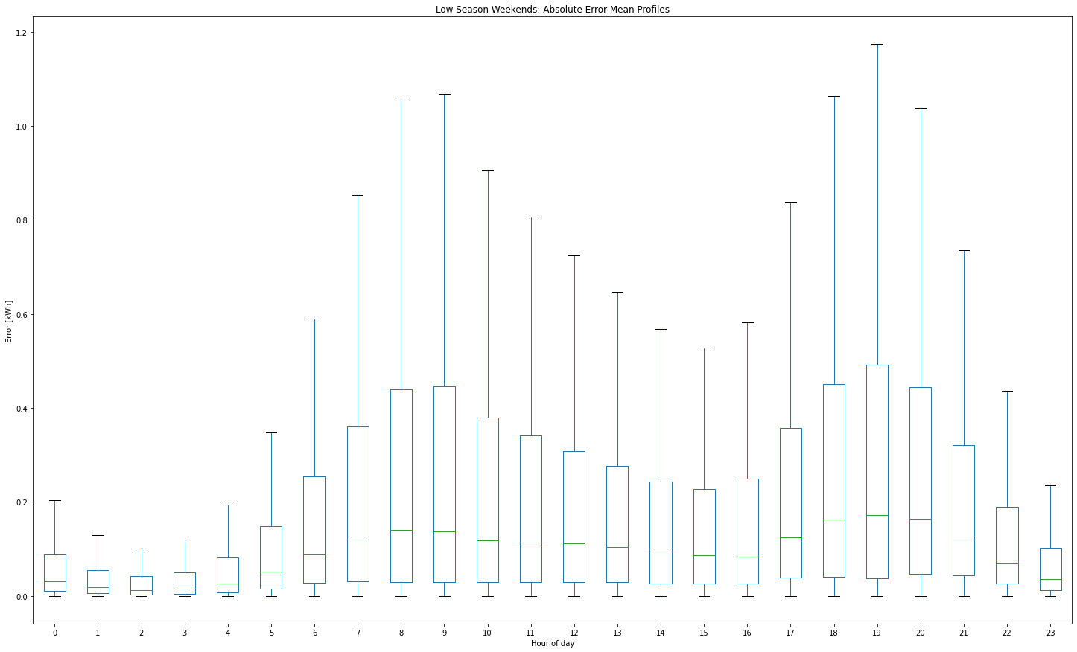
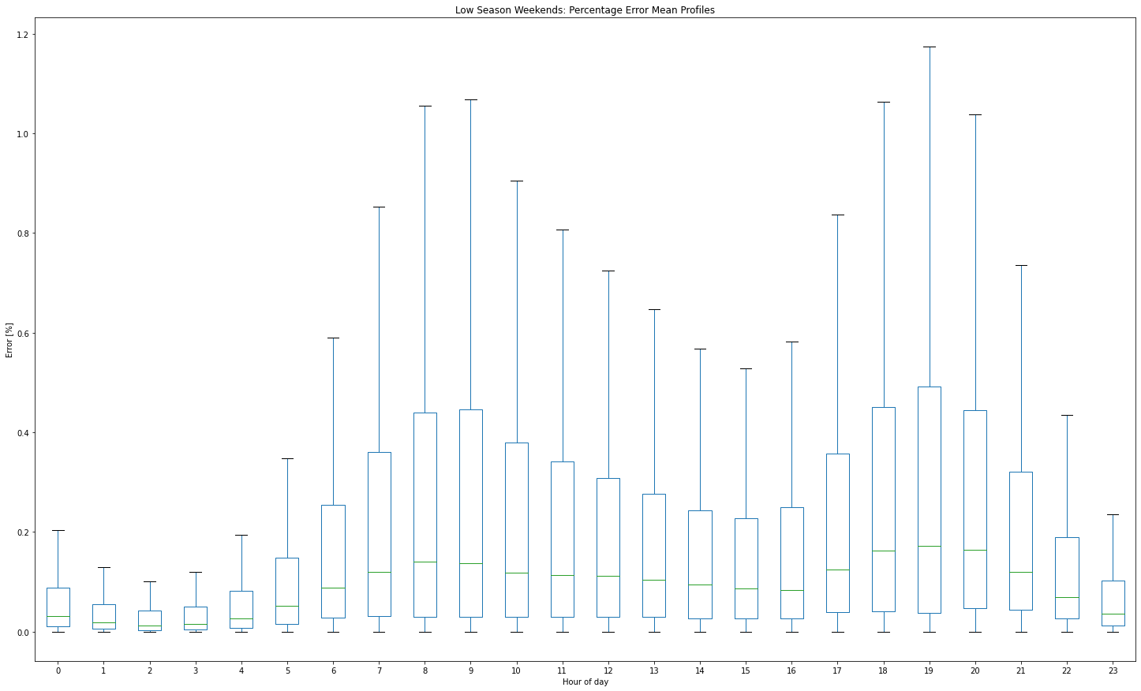
Synthetic Mean Profile: Hourly Error Boxplot
Boxplot with the absolute and percentage error per hour for all profiles per season

Slide 15
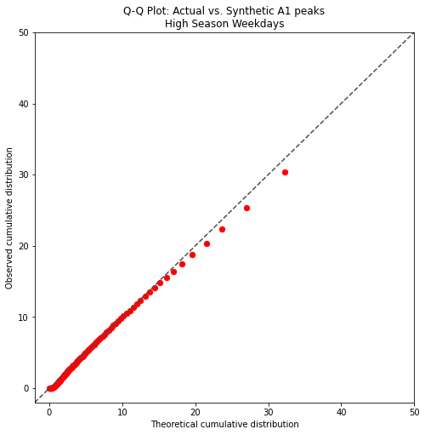
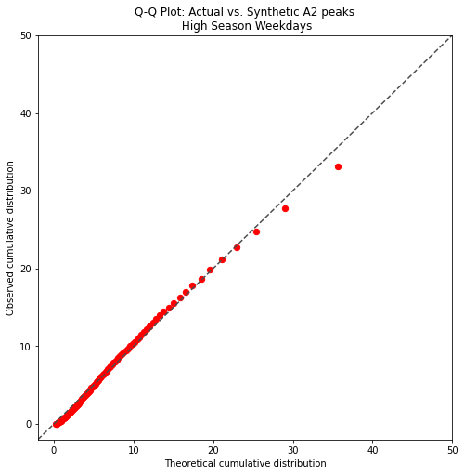
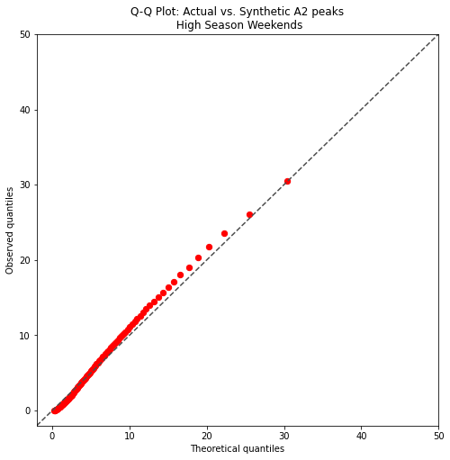
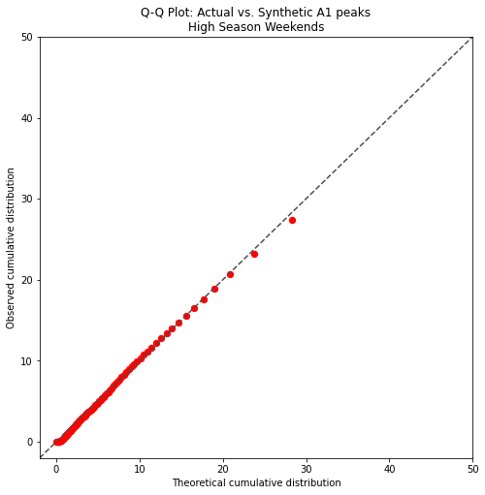
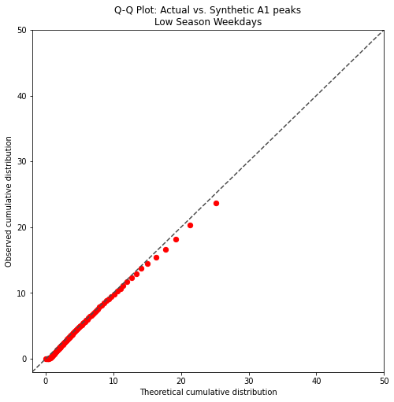
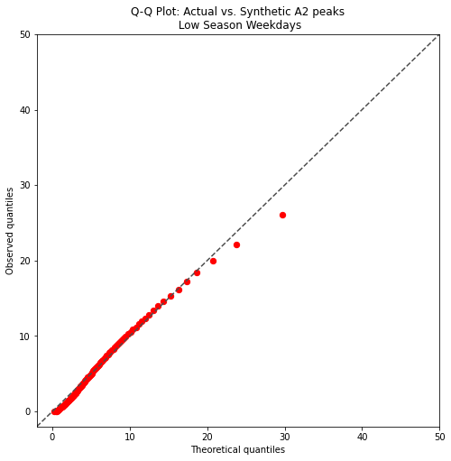

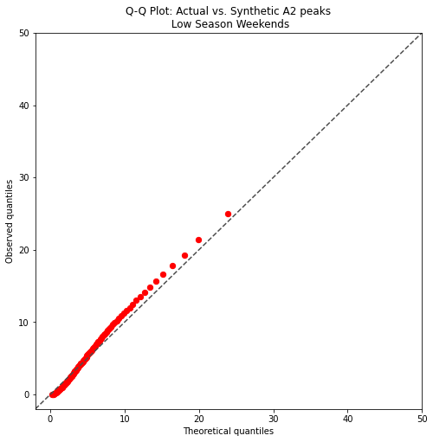
Q-Q Plots: Daily Peaks
If the two distributions being compared are identical, the Q–Q plot follows the 45° line y = x.

Slide 16
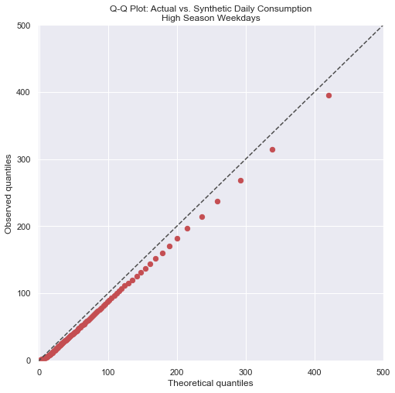

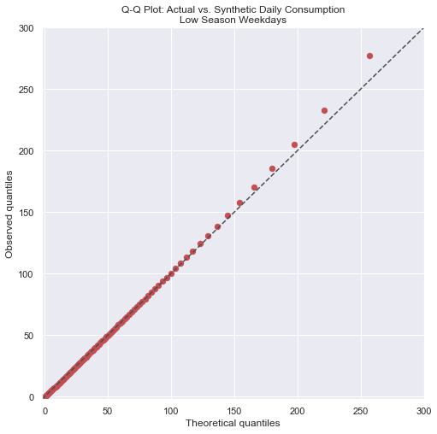

Q-Q Plots: Total Daily Consumption

Slide 17
Q-Q Plots: Aggregate Consumption

Slide 18
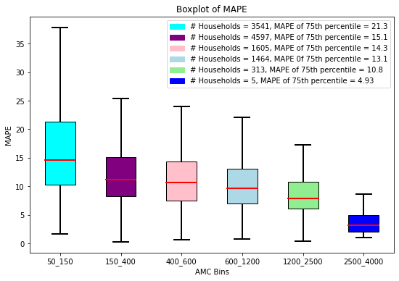
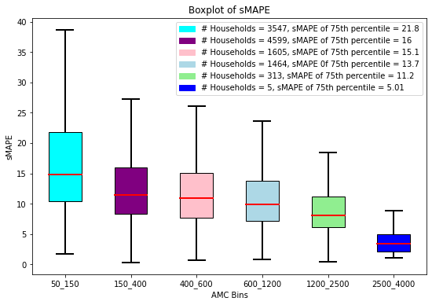
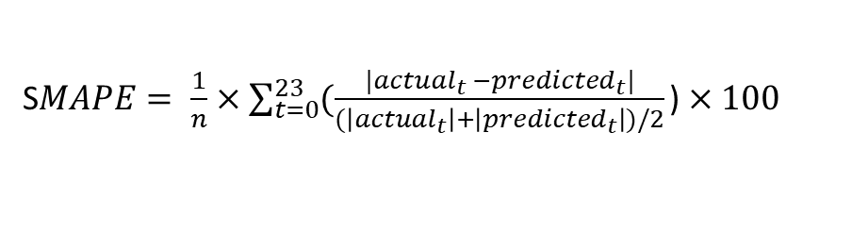
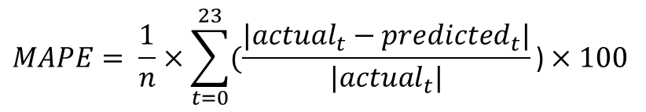
Synthetic Mean Profiles(Boxplots): Percentage Error
Percentage error between the synthetic(predicted) mean profile and the actual mean profile binned according to users average monthly consumption.
$$MAPE= \frac{1}{n}×\sum_{t=0}^{23}{(\frac{|{actual}_{t}−{predicted}_{t}|}{|{actual}_{t}|}\text{)}×100 }$$
S$MAPE= \frac{1}{n}×\sum_{t=0}^{23}{(\frac{|{actual}_{t} −{predicted}_{t}|}{(\left|{actual}_{t}\right|+\left|{predicted}_{t}\right|)/2}\text{)}×100 }$

Slide 19
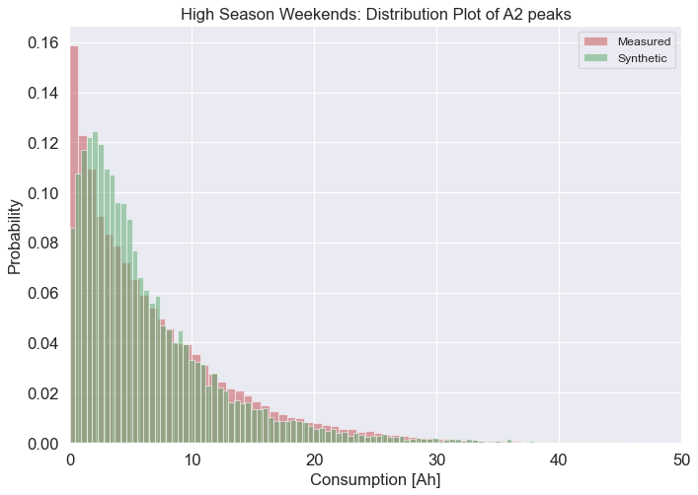
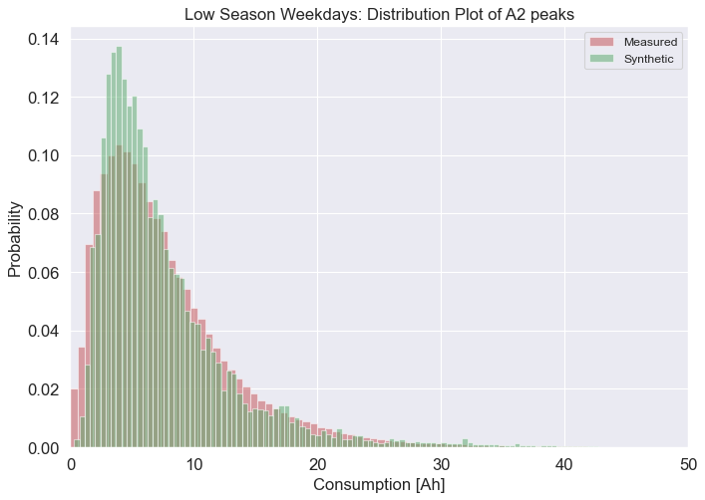
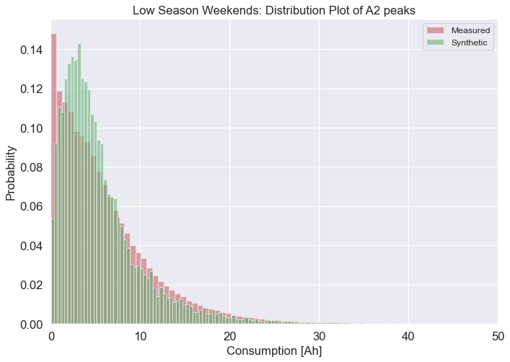

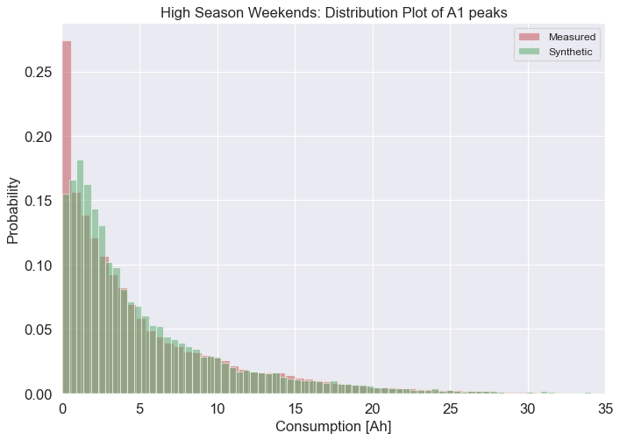
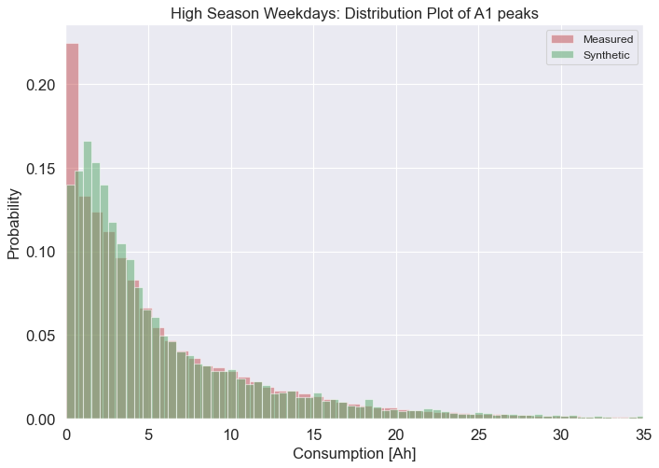
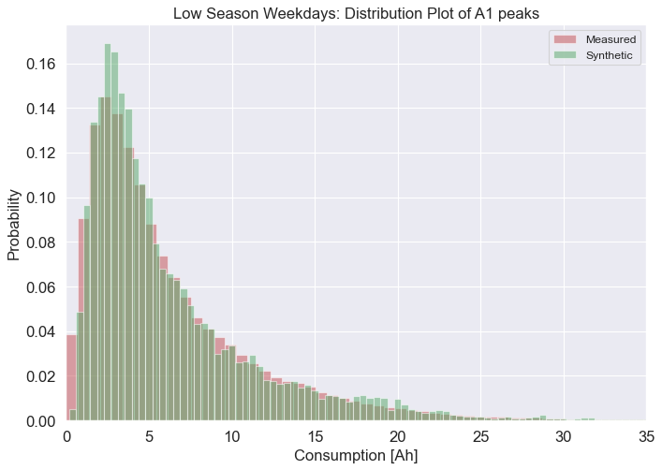

Synthetic Profiles: Daily Peaks (Histograms)
Check if synthetic profiles daily peaks match the measured profiles peaks.
Histogram of all daily peaks for all users.

Slide 20
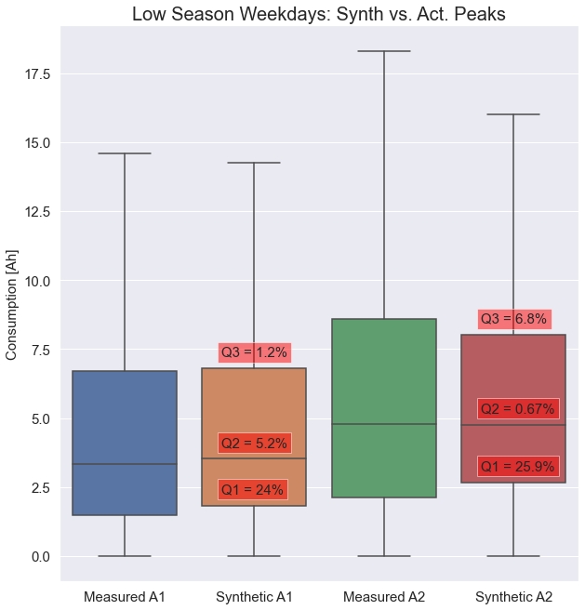
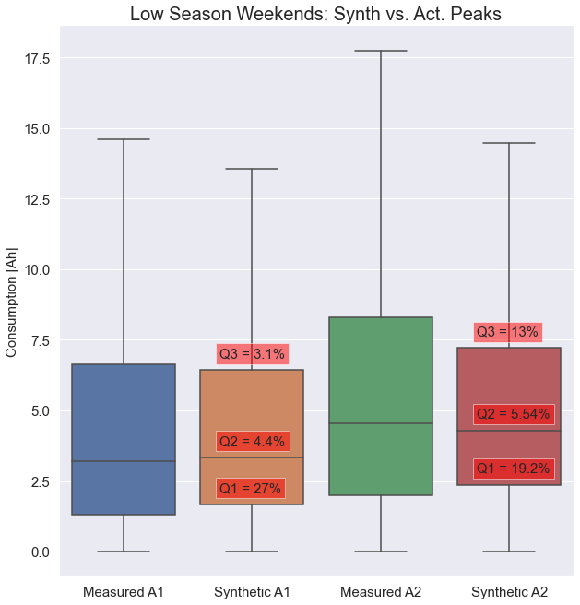
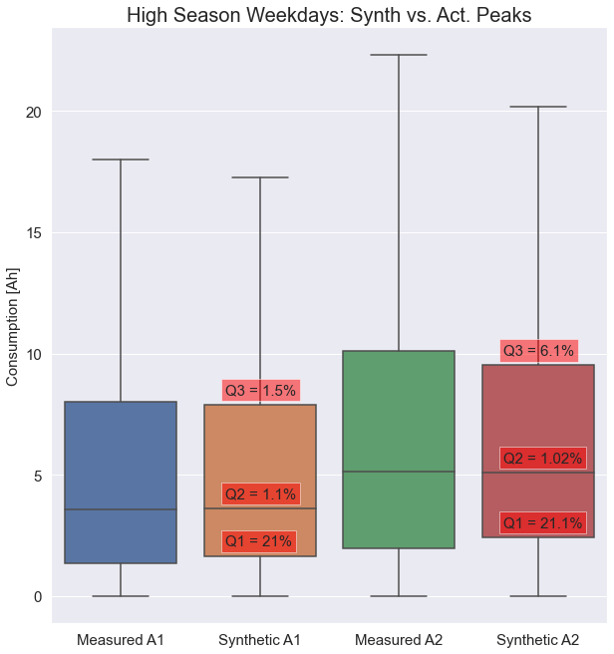

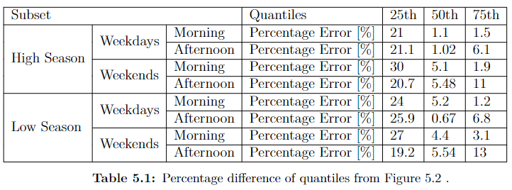
Synthetic Profiles: Daily Peaks (Boxplots)
Boxplots of daily peaks for all profiles of all users.
Table with the percentage difference between quantiles.
Largest difference at 25th quantile.
Model struggles to simulate low energy users.

Slide 21
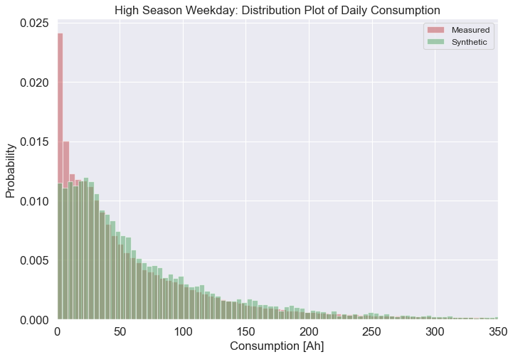
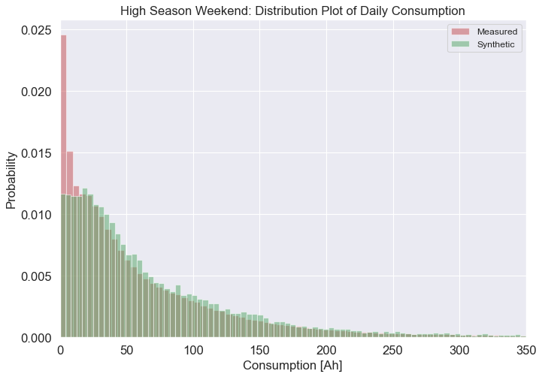


Synthetic Profiles: Daily Consumption(Histograms)
Distributions of the total daily consumption of the Actual and Synthetic Profiles

Slide 22




Synthetic Profiles: Aggregate Consumption(Histograms)
Distribution o the total consumption per season for the Actual and Synthetic Profiles

Slide 23



Synthetic Profiles: Grid Level Consumption(Histograms)

Slide 24
PV Results

Slide 25
PV Results: Synthetic vs. Actual Hourly Data

Slide 26
PV Results: 1st of every month
PV Results: First day of month

Slide 27
PV Results: Average Daily Profile

Slide 28
PV Results: Synthetic Load vs Utilized

Slide 29
PV Results: PV System Power Generated

Slide 30

PV Results: Percentage Utilized
Sort PV results according to a users years electrified.
Assumption:
Years electrified > 15 years, energy usage becomes more stable.
Years electrified < 15 years, energy use unpredictable.

Slide 31

PV Results: Percentage Exported Difference
Figure shows the difference between the percentage exported for the measured and synthetic data when using the same PV system

